Slide 1
Data Structures Workshop
Day 11

Slide 2
Workshop Outline
Exam 1 Comments (or trauma dump, I get it)
Starting on Exam 2 Content!
Stack Data Structure
Functionality
Stack Built-In Library
Stack as a Linked List
Stack Problem Examples

Slide 3
Stacks

Slide 4
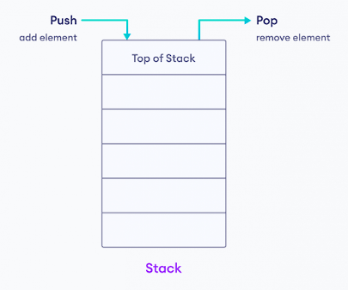
What is a Stack?
The stack data structure is a type of container that follows the “LIFO” principle (“Last In, First Out”), where elements are inserted and extracted from the end of the container.
Inserting elements will add to the “top” of the stack, while removing elements will remove the most recently added one to the stack (A.K.A. the “top” of the stack).
Most commonly implemented using Linked Lists or the STL C++ Library

Slide 5
Implementing Stacks as Linked Lists
Here are the different operations that we need to have to get the functionality of a stack:
push(item) → pushes a new element to the top of the stack
pop() → removes the top element of the stack
peek()/top() → returns element on top of the stack
isEmpty() → returns “true” if stack is empty

Slide 6
Restrictions
To keep the functionality of the stack data structure, there are certain things we can’t do with our linked list implementation of the stack itself!
Can only modify/access the “top” of our stack
Insert at top
Delete at top
Return top
You CANNOT traverse through a stack
Note: Since we only access the top of our stack in our function operations, we also know they are all done in O(1) time as well!

Slide 7
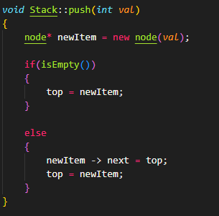
push(element) Function
Key Ideas: Adding new element to top of stack
If you take a close look at this, you’ll see that this is the same as the “addAtHead” function for Linked Lists!
The only difference here is that we’ll call our “head”, “top”!
Make a new node
Have it point to the head (top) of the linked list
Update what the new top is

Slide 8
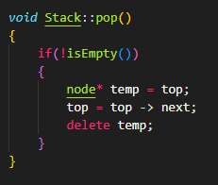
pop() Function
Key Ideas: Remove element from the top of the stack
Same as “removeAtHead” function for Linked Lists
Set a temp variable for your top node (for manual deallocation of memory later)
Set new top to the node after it
Delete the temp variable

Slide 9
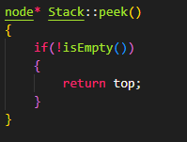
peek()/top() Function
Key Ideas: You want to return what’s at the top of the stack without popping it
Since our top variable already points to what’s at the top of the stack, we just need to return whatever top points to

Slide 10
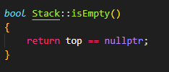
isEmpty() Function

Slide 11
Stack Problems

Slide 12
Reverse a String Using Stack
Given a string, reverse it using a stack
Input: “abcdef”
Output: “fedcba”

Slide 13
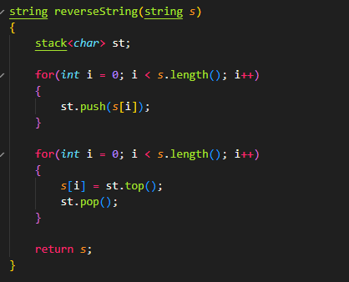
Solution

Slide 14
Valid Parentheses
Given an expression, find out whether or not that expression contains valid parentheses.
An expression contains valid parenthesis if it has the proper parenthesis ( ), [ ], { } in the correct order.
string = “{ [ ] ( ( ) ) }” → true
string = “{ ( ] ) } }” → false

Slide 15
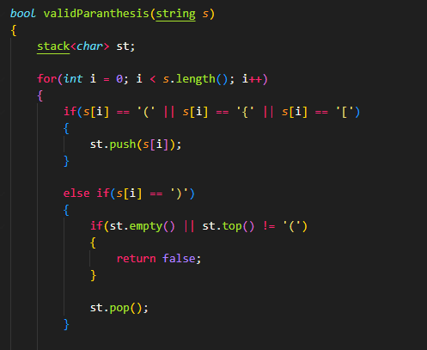
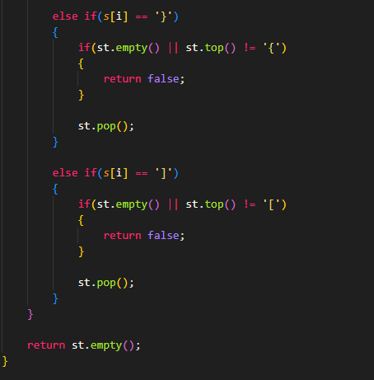
Solution

Slide 16
Getting rid of duplicates
Given a string, find the adjacent duplicates(two of the same character beside each other) and remove them using the stack.
Input: s = "abbaca
Ouput: "ca"

Slide 17
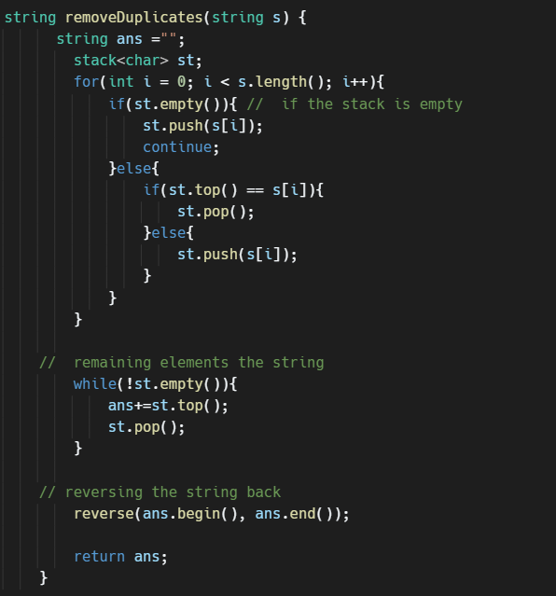
Solution

